Slide 1
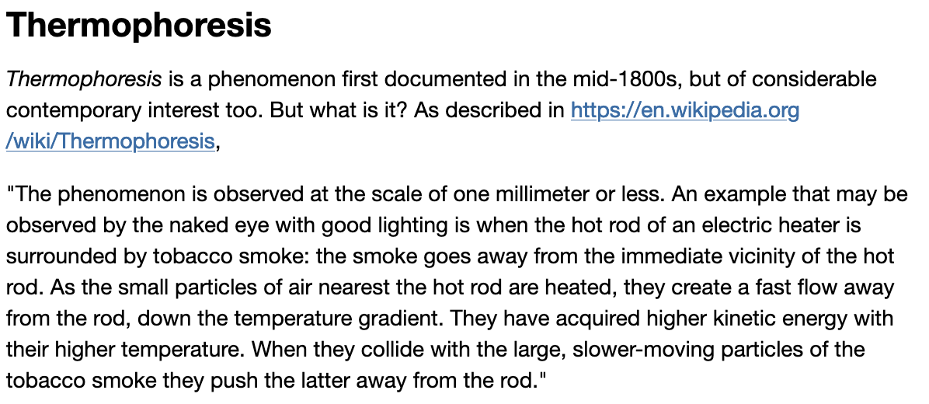
Week 14 – Thermophoresis
Etymology: thermo (“heat”) + phoresis (“to carry”)

Slide 2
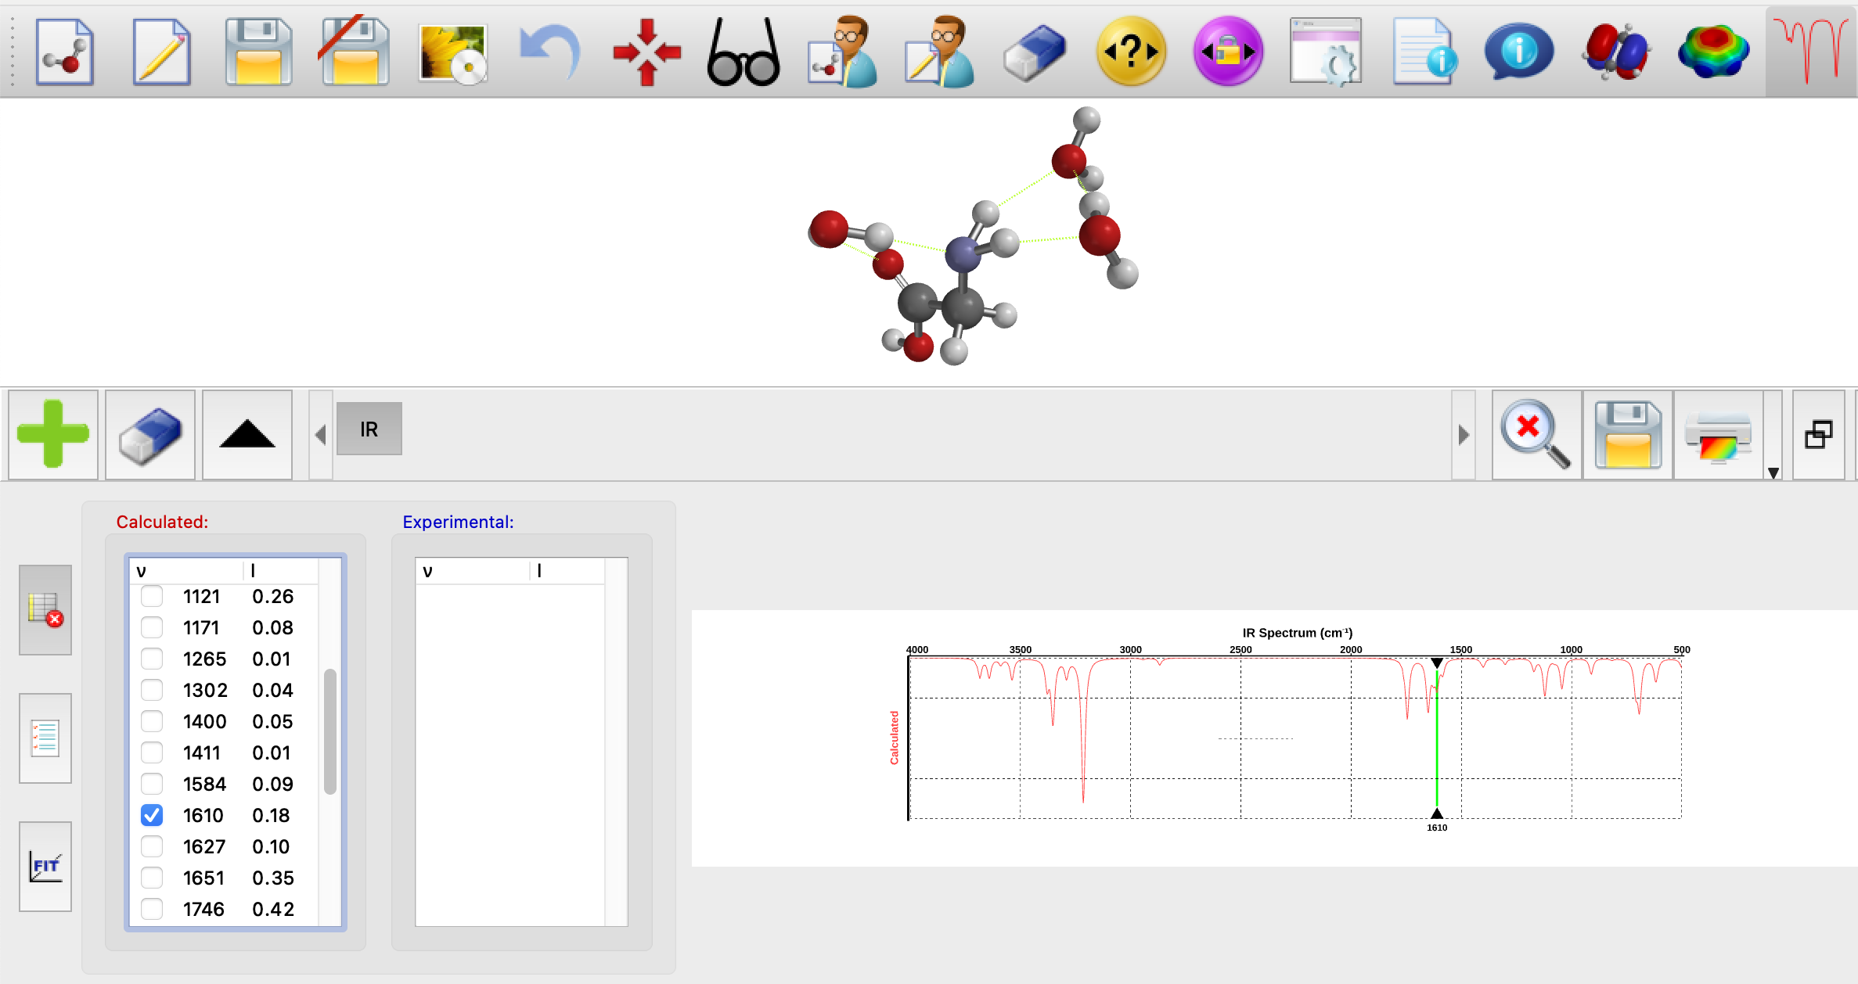
Week 14 – Frequency of the $R−NH_{2}$ (scissor) vibrational frequency
$${\overline{ν}}_{LT}$$

Slide 3
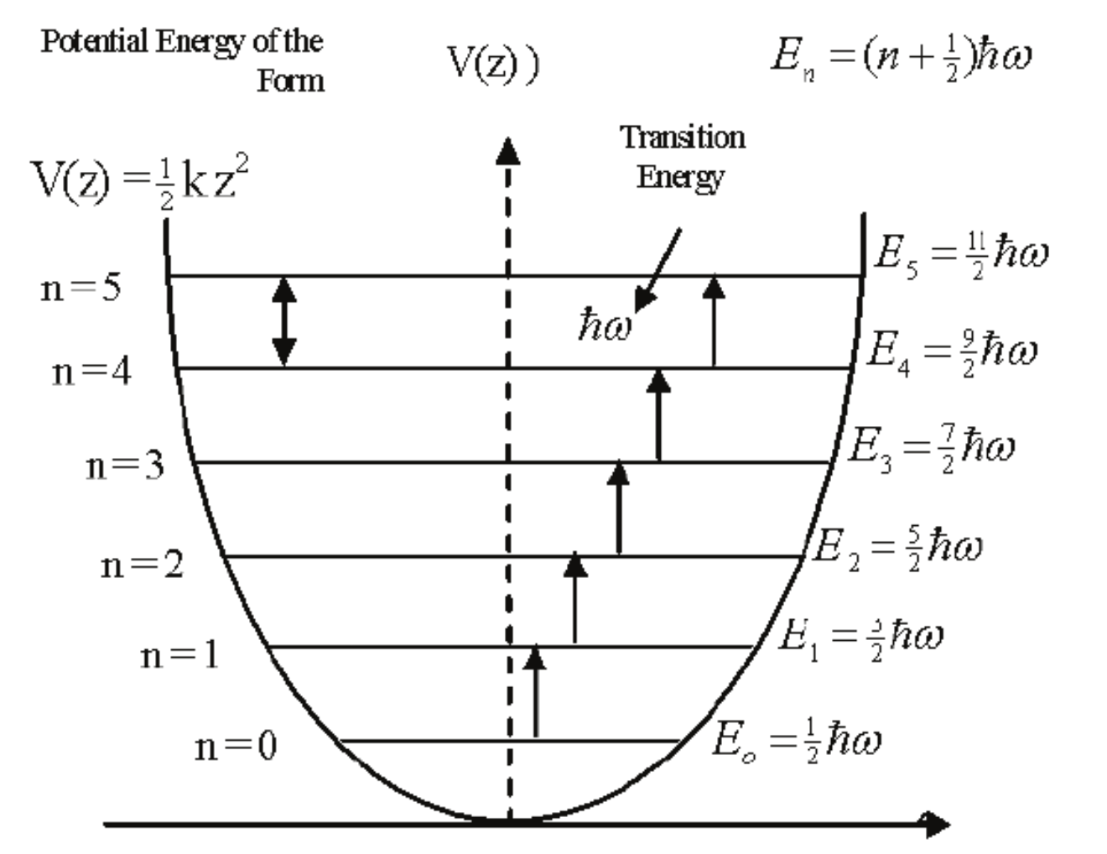

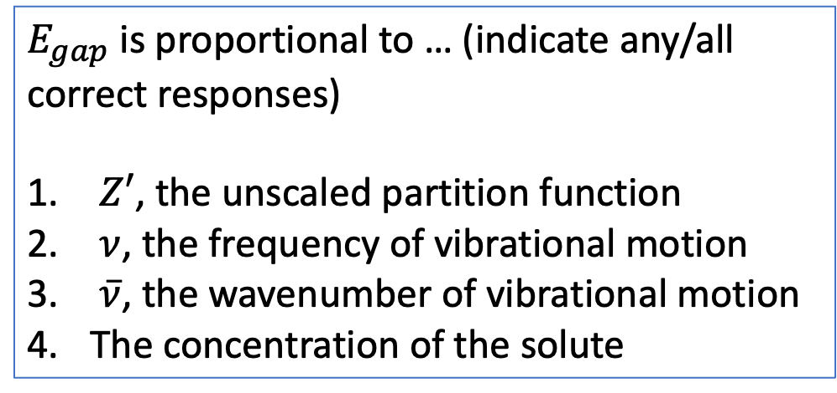



The kind of question I might ask
$E_{gap}$ is proportional to … (indicate any/all correct responses)
$Z′$, the unscaled partition function
$ν$, the frequency of vibrational motion
$\overline{ν}$, the wavenumber of vibrational motion
The concentration of the solute
$$E_{gap}$$
$$E_{gap}$$
$$E_{gap}$$
$$E_{gap}$$
$$E_{gap}$$

Slide 4
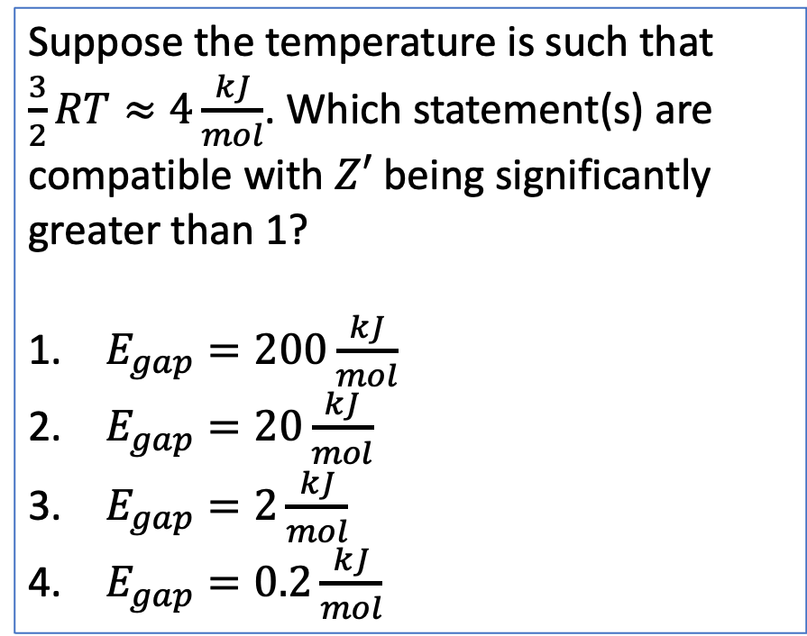



The kind of question I might ask
Suppose the temperature is such that $\frac{3}{2}RT≈4\frac{kJ}{mol}$. Which statement(s) are compatible with $Z′$ being significantly greater than 1?
$E_{gap}=200\frac{kJ}{mol}$
$E_{gap}=20\frac{kJ}{mol}$
$E_{gap}=2\frac{kJ}{mol}$
$E_{gap}=0.2\frac{kJ}{mol}$
$$E_{gap}$$
$$E_{gap}$$
$$E_{gap}$$
$$E_{gap}$$
$$E_{gap}$$

Slide 5
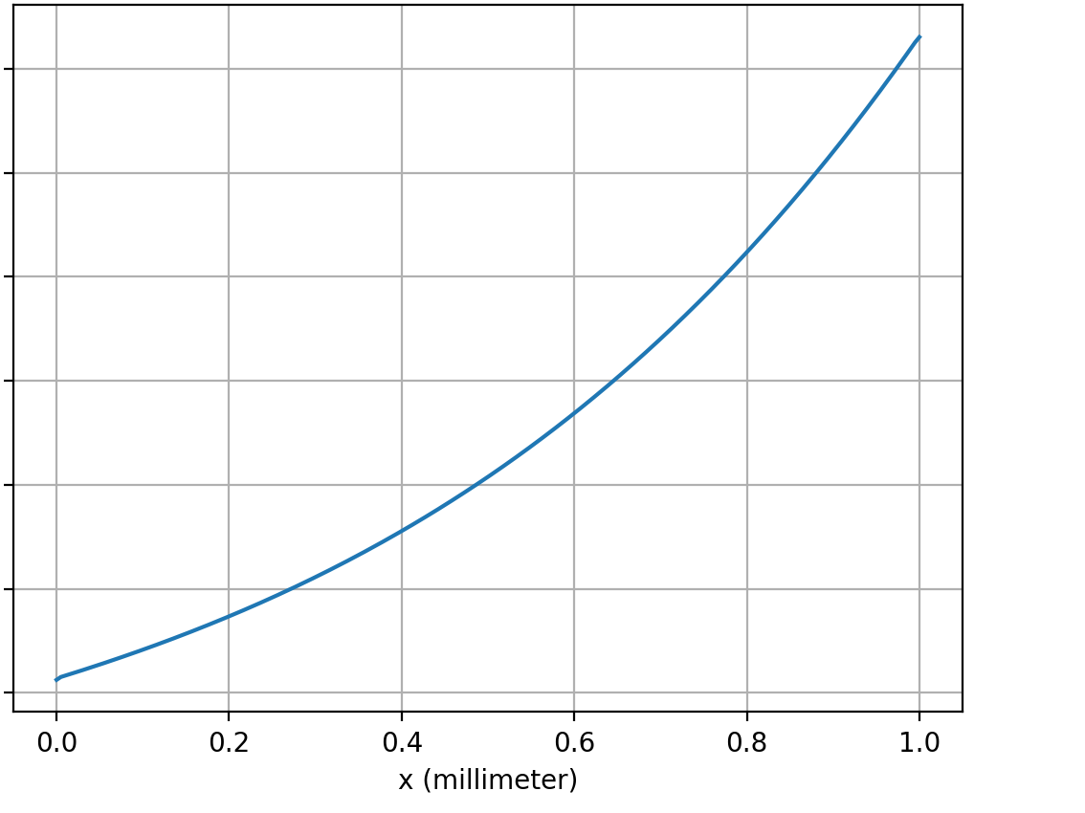
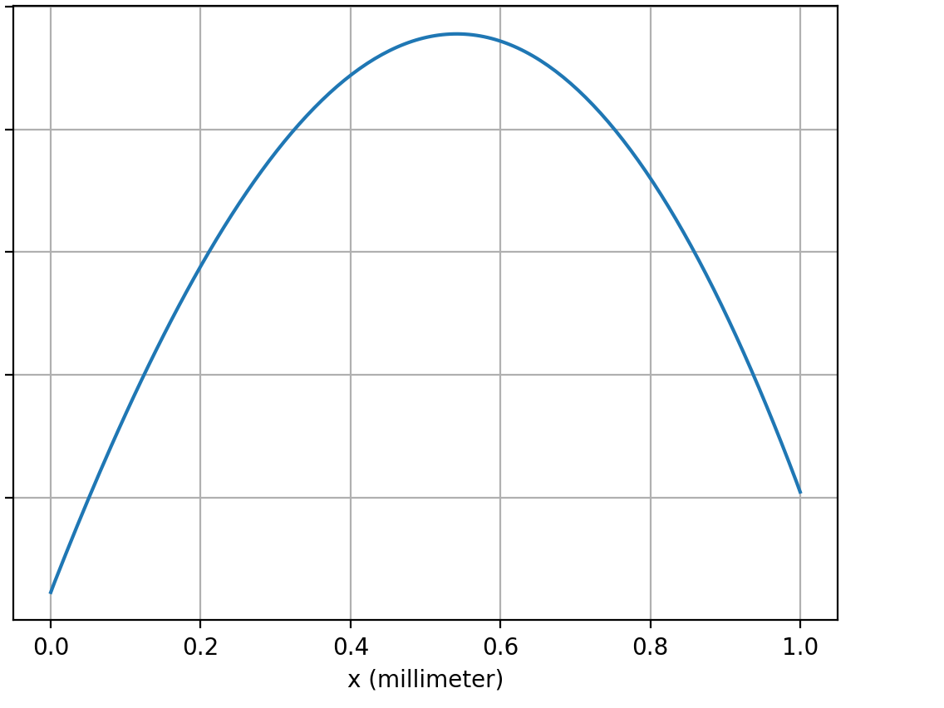
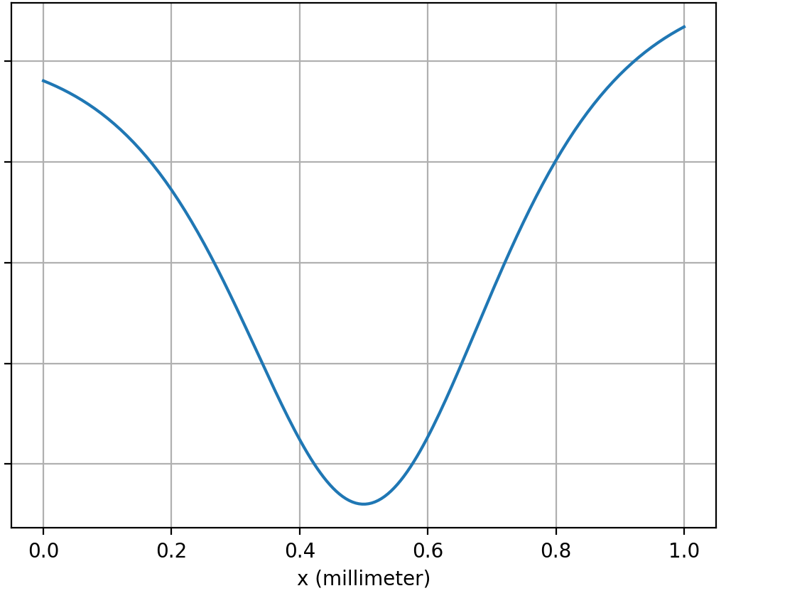
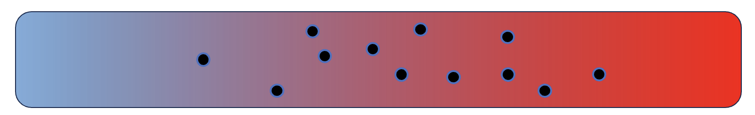
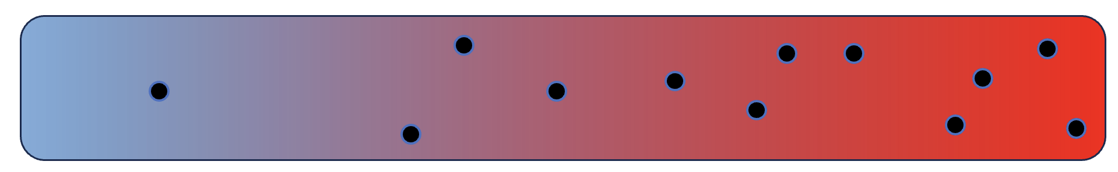
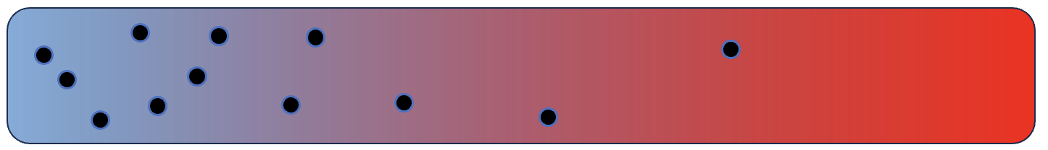
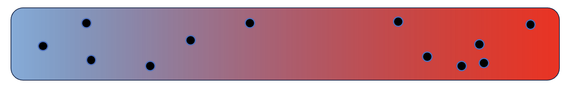
The kind of question I might ask
1
2
3
$${∆U}_{sol}$$
$${∆U}_{sol}$$
$${∆U}_{sol}$$
Which goes with which?
A
C
B
D

Slide 6
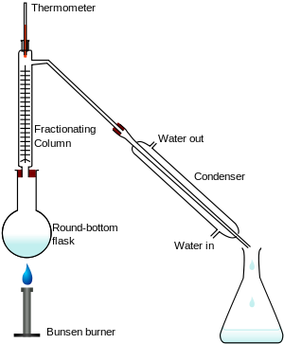
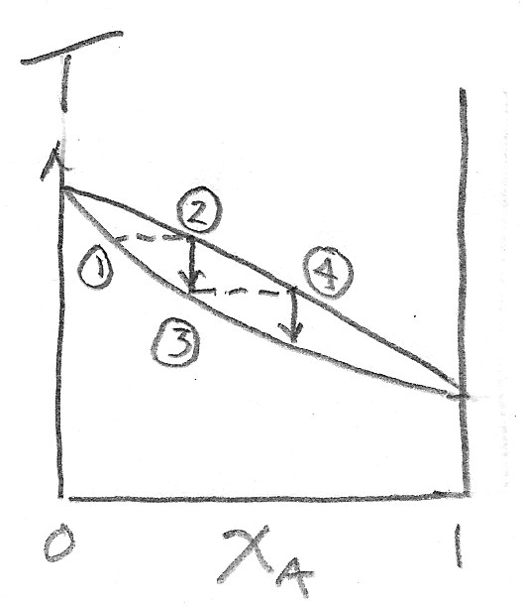
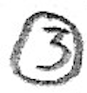


Week 15 – Fractional distillation
cold
vapor composition
hot
liquid composition

Slide 7
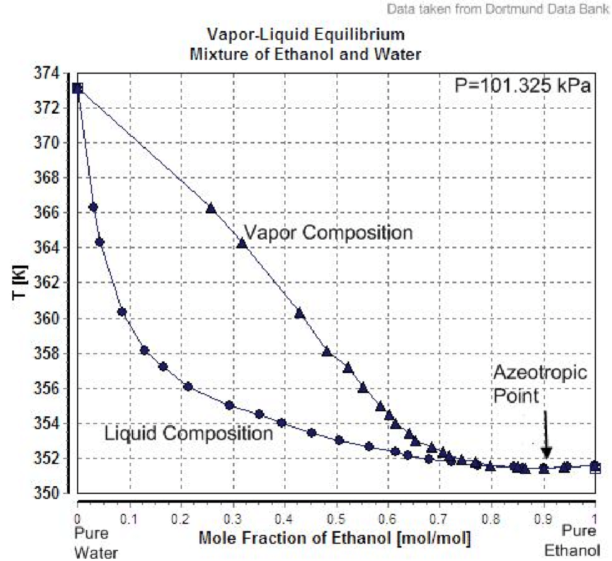
The kind of question I might ask
A liquid mixture that is 30% EtOH and 70% water is in equilibrium with its vapor. What’s true about the composition of the vapor?
It’s less than 30% EtOH
It’s equal to the liquid composition (30% EtOH, 70% water)
It’s greater than 30% EtOH, but not as high as the azeotropic point composition
It’s greater than the azeotropic point composition

Slide 8
The kind of question I might ask
If the liquid in the round bottom flask is 30% EtOH and 70% water, how many theoretical plates are required to yield a vapor having 70% EtOH and 30% water?
1-2
2-3
3-4
4-5

